Slide 1
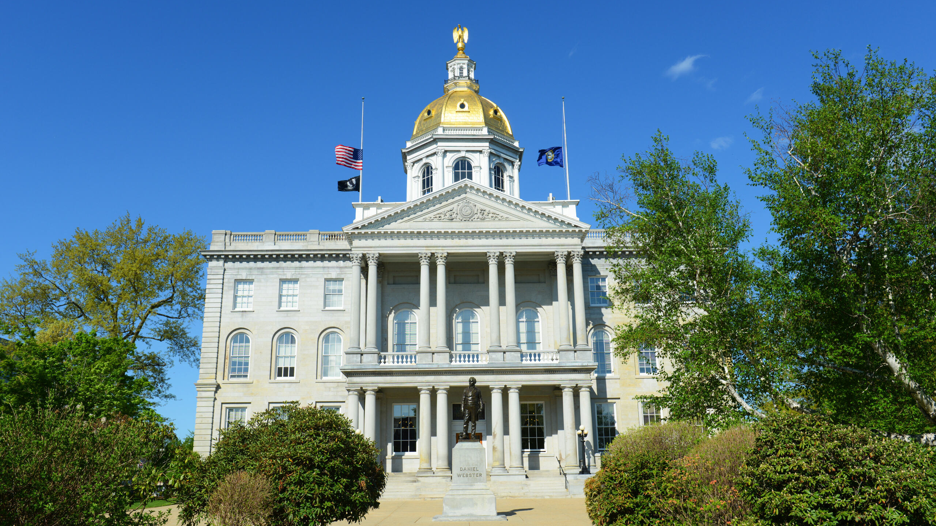
New Hampshire
Session Update
March 26, 2025
This NFIB event is being recorded and may be shared.
Notes:
Welcome, Thank You for joining us and thank you for supporting NFIB. Hot topic, big impact.
Introduce John and Ben
We’ll walk through background, details, and status of the Paid Family and Medical Leave proposal, and open it up for questions after. If you have questions along the way or would like clarification at any point, feel free to drop a message in the chat or use the ‘raise hand’ button.
Before we get started, this event is being recorded and may be shared.

Slide 2
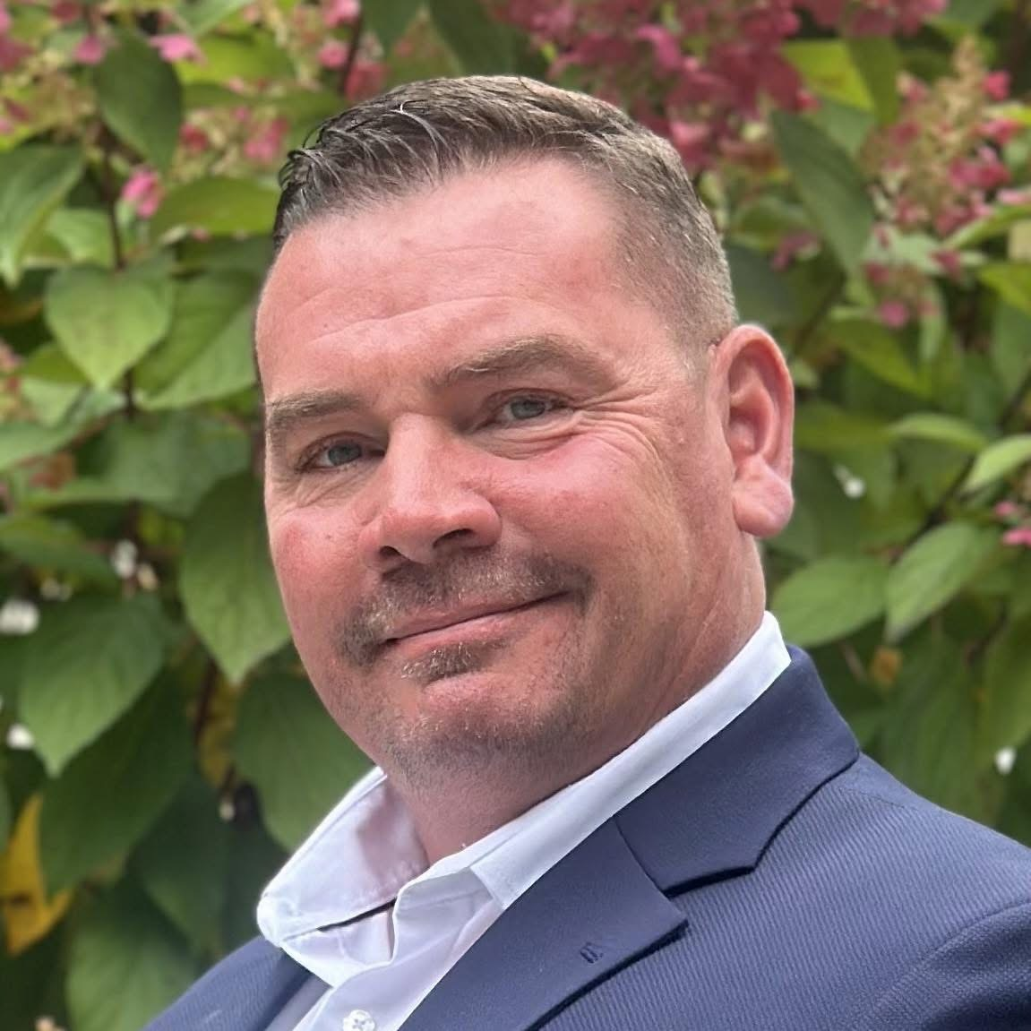
2025 New Hampshire Session Update
SPECIAL GUEST: REPRESENTATIVE BRIAN LABRIE
Lifelong Granite Stater
Hillsborough 2 (Bedford)
Small Business Owner
@NFIB
@NFIB
@NFIB
@NFIBdotcom
Notes:
MNsure, MNLARS

Slide 3
2025 New Hampshire Session Update
LEGISLATIVE LANDSCAPE
Governor Kelly Ayotte
NH House: 220 R / 177 D / 1 I (2 vacant)
NH Senate: 16 R / 8 D
@NFIB
@NFIB
@NFIB
@NFIBdotcom
Notes:
CA, 2002: 1st state with paid family and medical leave
New Jersey followed suit, then Rhode Island upped the ante with a family caregiving insurance program in 2013.
Eight more programs have passed since 2018.

Slide 4
2025 New Hampshire Session Update
BIG PICTURE FOR SMALL BUSINESS
State Budget for FY 26-27
Business Taxes
Business Regulation
@NFIB
@NFIB
@NFIB
@NFIBdotcom

Slide 5
2025 New Hampshire Session Update
GOVERNOR’S BUDGET PROPOSAL
Governor Ayotte, FY26-27
All Funds Revenue/Expenses: $16B
Federal Funds Revenue: $5.2B
Unrestricted General & Education Fund Revenue: $6.4B
BPT + BET Revenue: $2.5B
Meals & Rooms: $724M
I&D Tax: fully repealed 1/1/2025
Notable Items:
Reduce General Fund spending by $150m
+50% in state Special Education funding
Workforce Training Funding
Expanding Education Freedom Accounts
Bail Reform
Source: Governor’s Executive Budget Presentation, Feb. 2025
@NFIB
@NFIB
@NFIB
@NFIBdotcom
Notes:
FY24-25: ~$15B Total Expenditures (both figures do not count transfers)
FY24-25: ~$6.6B Unrestricted State Revenue (Ayotte reducing GF spending by $150m)
Business Taxes: revenue declined sharply from FY 24 to FY 25 (Gov expects quick rebound, House estimates slower)
Other differences: new video gaming terminal revenue at charity casinos (not included in House estimates)

Slide 6
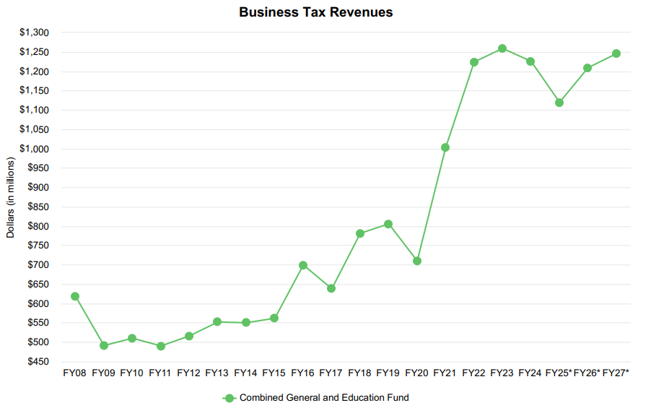
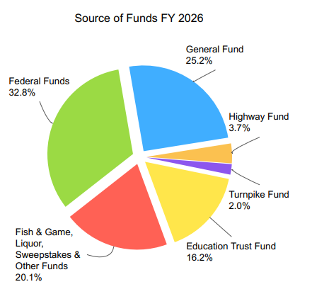
2025 New Hampshire Session Update
GOVERNOR’S BUDGET PROPOSAL
PROJECTED REVENUES
Source: Governor’s Executive Budget Presentation, Feb. 2025
@NFIB
@NFIB
@NFIB
@NFIBdotcom
Notes:
FY24-25: $15.2B Total Expenditures (both figures do not count transfers)
Business Taxes: revenue declined sharply from FY 23 to FY 25 (-~$130m)
Gov expects quick rebound, House estimates slower recovery
Other differences: new video gaming terminal revenue at charity casinos (not included in House estimates)

Slide 7
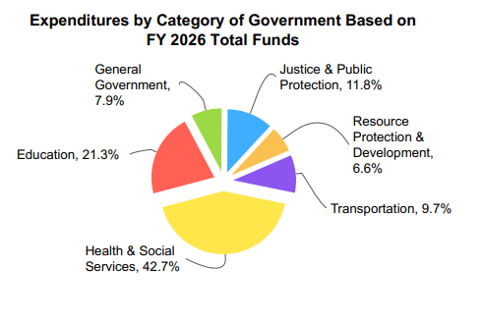
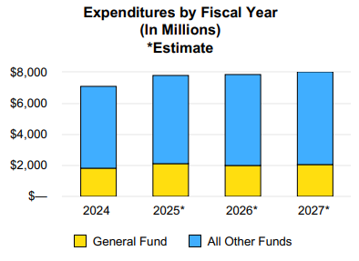
2025 New Hampshire Session Update
GOVERNOR’S BUDGET PROPOSAL
PROPOSED EXPENDITURES
Source: Governor’s Executive Budget Presentation, Feb. 2025
@NFIB
@NFIB
@NFIB
@NFIBdotcom
Notes:
FY24-25: $15.2B Total Expenditures (both figures do not count transfers)
FY24-25: Unrestricted State Revenue: $
Business Taxes: revenue declined sharply from FY 24 to FY 25 (Gov expects quick rebound, House estimates slower)
Other differences: new video gaming terminal revenue at charity casinos (not included in House estimates)

Slide 8
2025 New Hampshire Session Update
HOUSE BUDGET PROJECTIONS
NH House
Revenue projections differ from Gov.
Lower Revenues in FY25:
-$150m vs. Gov.
Lower total revenue in FY26-27
Gen & Ed Total: $5.9B (-$500m vs. Gov.)
BPT+BET Revenue: $2.2B (-$300m vs. Gov)
Education Freedom Accounts
YDC Settlements
Education Funding Lawsuits
@NFIB
@NFIB
@NFIB
@NFIBdotcom
Notes:
VT, early 2025: Business and Income Tax up ~10%
ME, FY 25: revenue above projections
MA, FY 25: revenue above projections

Slide 9
2025 New Hampshire Session Update
BUSINESS TAXES
BET Reduction (HB 155)
Prime Sponsor: Rep. Joe Sweeney (Salem)
Reduce BET Rate from 0.55% to 0.50%
$20 million savings over three years
NFIB Supported, committee retained bill
Business & Investment Tax Hikes (HB 503)
Prime Sponsor: Rep. Tom Schamburg (Wilmot)
BPT: 8.5%, BET: 0.75%, , I&D: 5%, Meals: 9%
Nearly $900m tax increase in FY25-27
NFIB Opposed, House ITL: 345-27
Carbon Sequestration Timber Tax (HB 123)
Prime Sponsor: Rep. Arnold Davis (Milan)
For Standing Timber enrolled in carbon sequestration program: 10% Tax on carbon offset credits
@NFIB
@NFIB
@NFIB
@NFIBdotcom

Slide 10
2025 New Hampshire Session Update
BUSINESS REGULATIONS
$15/Hour Minimum Wage (SB 176, HB 726)
Prime Sponsors: Sen. Altschiller (Stratham); Rep. Kathy Staub (Manchester)
NFIB Opposed
Senate ITL: 16-8
Unused Vacation Payout (HB 378)
Prime Sponsor: Rep. Michael Cahill (Newmarket)
Requires payout of unused vacation to employee upon separation in certain situations
NFIB Opposed, House ITL: 193-169
Unemployment Benefits Hike (HB 542)
Prime Sponsor: Rep. Mark MacKenzie (Manchester)
Increases max weekly payment from $427 to $669 (+57%)
Higher UI Taxes, Longer Unemployment Claims
NFIB Opposes; House Laid On Table
Workers’ Comp Payout Hike (HB 744)
Prime Sponsor: Rep. Mark MacKenzie (Manchester)
Increases weekly payout from 60% to 66 2/3 % (+11%)
Will increase WC premiums, longer claims
NFIB Opposes; House Laid on Table
@NFIB
@NFIB
@NFIB
@NFIBdotcom
Notes:
UI: Committee ITL 11-9, House laid on table
WC: Committee ITL 11-9, House Laid on table
Action alert:

Slide 11
2025 New Hampshire Session Update
BUSINESS REGULATION AND OTHER LEGISLATION
Clinician Administered Medicine (SB 256)
Prime Sponsor: Sen. Tim McGough (Merrimack)
Prohibits insurers and PBMs from engaging in wasteful practices that delay treatment
Safeguards to protect plan sponsors from higher costs
NFIB Supported; Committee retained.
Post-Pregnancy Time Off (SB 246)
Prime Sponsor: Sen. Denise Ricciardi (Bedford)
Provides employees with 25 hours of unpaid time off during and in first year after birth for medical appts, etc.
No parallel in NH law, not consistent with FMLA
NFIB opposed. Outcome TBD
State Primary Date
Various Proposals to Move Up State Primary:
HB 481: 2nd Tuesday in June (committee support)
HB 408: 4th Tuesday in August (committee opposed)
Gov. Ayotte prefers June Primary
Voting Time Off (HB 52)
Prime Sponsor: Ellen Read (Newmarket)
Allows all employees to take up to 3 hours off to vote
NFIB opposed. House Opposed: 205-166
@NFIB
@NFIB
@NFIB
@NFIBdotcom
Notes:
UI: Committee ITL 11-9, House laid on table
WC: Committee ITL 11-9, House Laid on table
Action alert:

Slide 12
@NFIB
@NFIB
@NFIB
@NFIBdotcom
12

Slide 13
Q
&
A
Notes:
Feel free to drop questions in the chat or use the button to raise your hand.

Slide 14
THANK YOU FOR ATTENDING
John Reynolds
New Hampshire State Director
O: 603-932-7757
C: 845-527-8280
John.Reynolds@NFIB.org
Julianna Rauf
Grassroots Manager
P: 218-969-5121
Julianna.Rauf@NFIB.org
@NFIB
@NFIB
@NFIB
@NFIBdotcom

